Slide 1
Introduction to Fission Gas Behaviour Modelling in Nuclear Fuel
Lelio Luzzi

Slide 2
Nuclear fuel rod
Stack of oxide (UO₂ / MOX) fuel pellets wrapped in metallic (zircaloy / stainless steel) cladding.
Used in both thermal and fast reactors.
Its performance is fundamental for safety and efficiency.
Spring
Plenum
Cladding
Fuel
Gap
Helium

Slide 3
Nuclear fuel rod
Use of fuel performance codes and integral irradiation experiments:
To assess the fuel rod thermo-mechanical behaviour (σ, ε, and T)
Fission gas behaviour = gaseous swelling & fission gas release
How does fission gas affect the safety and performance of the fuel rod?
Spring
Plenum
Cladding
Fuel
Gap
Helium

Slide 4
Nuclear fuel rod behaviour
Thermo-mechanics
Modelling and simulation of many interrelated phenomena:
Thermo-mechanical
Thermo-chemical
Micro-structural evolution
Irradiation effects on materials
Coolant temperature
Thermo-chemistry
Power
Cladding temperature
Irradiation effects on material
Neutronics
Fuel temperature
Micro-structural evolution
Fission products

Slide 5







Nuclear fuel rod, multi-scale modelling approach
Engineering scale, fuel rod
Fuel pellet
Fuel grain-scale, microstructure
Spring
Plenum
Gap
Pellet
Grain boundary
Cladding
Grains
Cladding
Fuel
Grain boundary
Gap
Intergranular bubbles
Helium

Slide 6
SCIANTIX: Physics-Based Modelling of Fission Gas Behaviour

Slide 7
SCIANTIX and the Challenge of Multi-Scale Fuel Modelling
Davide Pizzocri

Slide 8
Multi-scale modelling approach, requirements
Physics-based models, to bridge between different scales:
From the atomic scale
Up to the macroscopic, engineering scale of the fuel rod
Requirements:
Numerical robustness
Low computational time for effective use within fuel performance codes
Meso-scale model called at each thermo-mechanical iteration, in each time-step of the simulation, in each mesh point
Possibly, open-source!
Plenum
Spring
Cladding
Fuel
Gap
Helium
Grain boundary
Intergranular bubbles

Slide 9
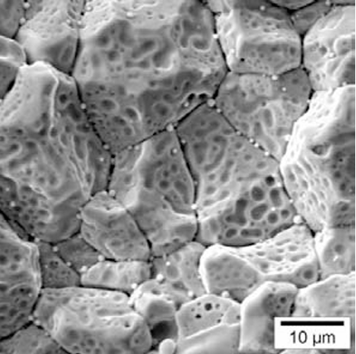
Nuclear fuel, UO₂ grain

Slide 10

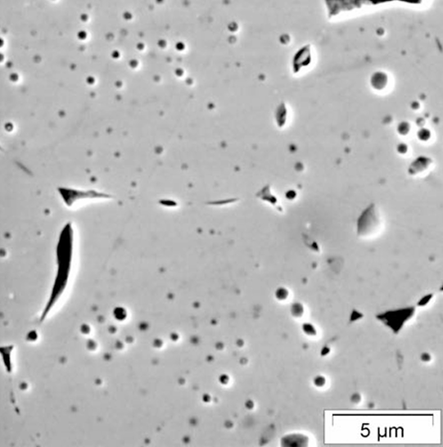
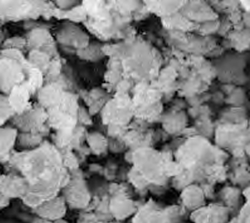
Fission gas behaviour, main physical aspects
Fission reactions
Fission gases (Xe, Kr) and fission products (Cs, I, Te, …)
Intra-granular (single atoms)
Diffusion
Trapping
Inter-granular / grain-boundary bubbles
Intra-granular bubbles
Re-solution
Gaseous fuel swelling
Grain-face saturation and/or micro-cracking
High-burnup structure
Fission gas release

Slide 11

SCIANTIX, fission gas behaviour modelling
Zero-dimensional (0D) stand-alone code
Developed at Politecnico di Milano
To model fission gas behaviour using physics-based approaches
Designed for the development, verification, and validation of fission gas behaviour models, as well as for the simulation of separate-effect test experiments
Can be integrated into multi-physics platforms and fuel performance codes
SCIANTIX 2.0 released as open-source software under the MIT license

Slide 12



SCIANTIX, main features
0D stand-alone code, describing fission gas behaviour with physics-based approaches:
Stable and radioactive fission gases, helium
Gaseous swelling, fuel microstructure
Standard version
https://github.com/sciantix/sciantix-official
Verified (method of manufactured solutions)
Validated (separate-effect experiments)
Regression test available
Coupling with fuel performance codes (LWR)
TRANSURANUS (JRC-Ka)
FRAPCON/FRAPTRAN (CIEMAT, Madrid)
OFFBEAT (EPFL, Lausanne)

Slide 13
Fission Gas Evolution and Validation in SCIANTIX
Lelio Luzzi
Notes:
Numerazione corretta

Slide 14
Intra-granular fission gas behaviour
Fission reactions
Fission gases (Xe, Kr) and fission products (Cs, I, Te, …)
Intra-granular (single atoms)
Diffusion
Trapping
Inter-granular / grain-boundary bubbles
Intra-granular bubbles
Re-solution
Gaseous fuel swelling
Grain-face saturation and/or micro-cracking
High-burnup structure (HBS)
Fission gas release

Slide 15
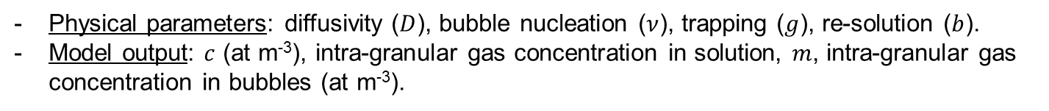
The SCIANTIX code, intra-granular fission gas behaviour
Gap
Pellet
Grain boundary
Grains
Cladding
Grain boundary
Intergranular bubbles

Slide 16
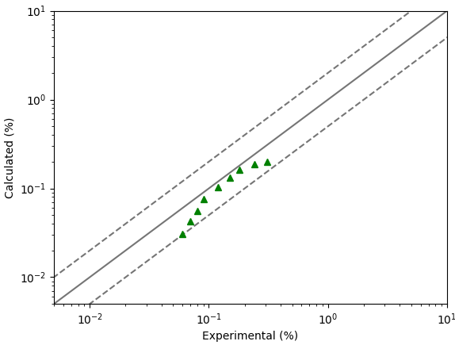
Intra-granular bubble evolution, separate effect validation
Figure of merit: Intra-granular gaseous swelling
Separate-effect validation performed in SCIANTIX: agreement with experimental data
Experimental data from Baker, 1977, JNM.
Calculation from G. Zullo, PhD Thesis, 2024.

Slide 17
Inter-granular fission gas behaviour
Fission reactions
Fission gases (Xe, Kr) and fission products (Cs, I, Te, …)
Intra-granular (single atoms)
Diffusion
Trapping
Inter-granular / grain-boundary bubbles
Intra-granular bubbles
Re-solution
Gaseous fuel swelling
Grain-face saturation and/or micro-cracking
High-burnup structure
Fission gas release

Slide 18
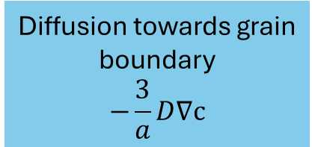
The SCIANTIX code, inter-granular fission gas behaviour
Fission gases from the intra-granular diffusion are accumulated in grain-boundary bubbles
Grain boundary bubble evolution leads to fission gas release and gaseous swelling
Gap
Pellet
Grain boundary
Grains
Cladding
Grain
Grain boundary
Fission gas release
Trapping
Re-solution
Fission gas in grain-boundary bubbles

Slide 19
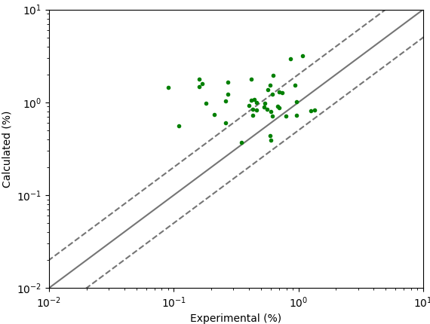
Inter-granular bubble evolution, separate effect validation
Figure of merit: Inter-granular gaseous swelling
Separate-effect validation performed in SCIANTIX: agreement with experimental data
Data from White, 2004.
Calculation from G. Zullo, PhD Thesis, 2024.

Slide 20
Inside SCIANTIX: Structure, Extensions and Advanced Features
Davide Pizzocri
Notes:
Numerazione corretta

Slide 21
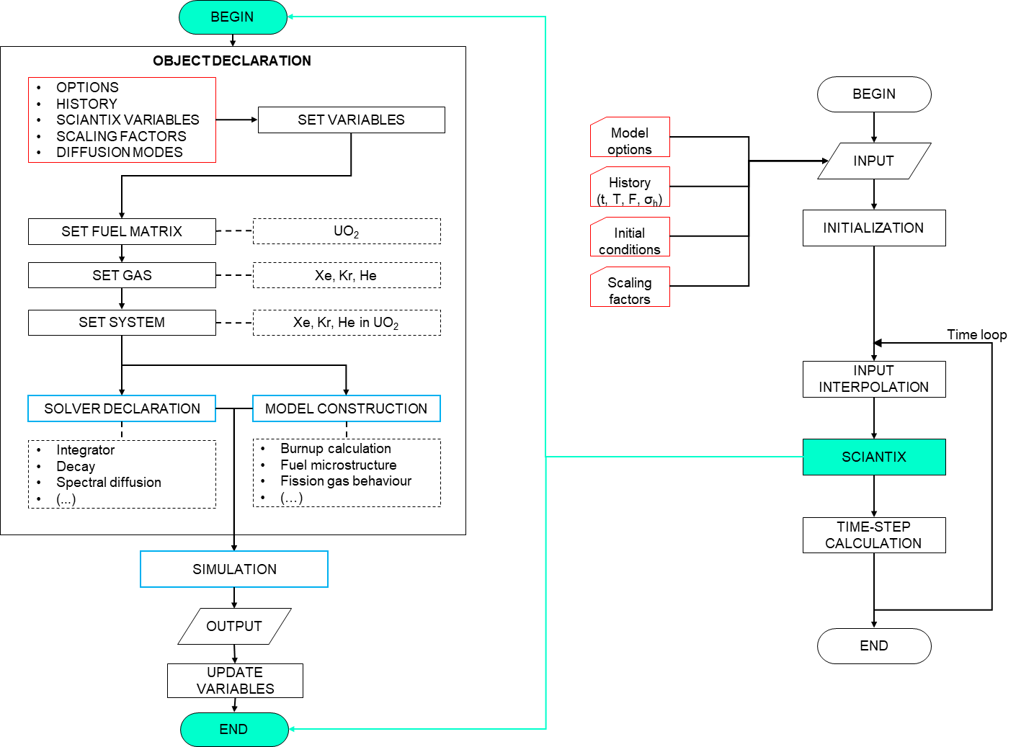
The SCIANTIX flowchart
External shell (right) representing the coupling with fuel performance codes (TRANSURANUS, OFFBEAT, …)
Meso-scale module (left) containing physical / behavioural models
Construction of specific objects for fission gas behaviour modelling
Definition of solvers (robust numerics)
Simulation = models + solvers
  Verification and validation, continuous activities, matrix of cases for non-regression tests

Slide 22
The SCIANTIX inheritance diagram
Variable
Variable
Material
Material
Variable
PhysicsVariable
PhysicsVariable
Variable
Gas
Matrix
InputVariable
HistoryVariable
SciantixVariable
InputVariable
System
Solver
Model
Simulation

Slide 23

The SCIANTIX inheritance diagram
Variable
Variable
Material
Material
Variable
PhysicsVariable
PhysicsVariable
Variable
Gas
Matrix
InputVariable
HistoryVariable
SciantixVariable
InputVariable
System
Helium in UO₂ / MOX
Solver
Model
Helium behaviour
Production
Diffusion
Solubility
Interaction with fission gases 🡪 bubbles
Simulation

Slide 24

The SCIANTIX inheritance diagram
Variable
Variable
Material
Material
Variable
PhysicsVariable
PhysicsVariable
Variable
Gas
Matrix
InputVariable
HistoryVariable
SciantixVariable
InputVariable
System
Cesium (Cs), Iodine (I), Tellurium (Te),
CsI, … in … UO₂/MOX
Solver
Model
Interaction with thermochemistry module
Useful for experimental design (source term estimation)
Step towards Joint Oxyde-Gaine models
Simulation

Slide 25

The SCIANTIX inheritance diagram
Variable
Variable
Material
Material
Variable
PhysicsVariable
PhysicsVariable
Variable
Gas
Matrix
InputVariable
HistoryVariable
SciantixVariable
InputVariable
System
Solver
Model
Connected to fuel microstructure (e.g., high-burnup structure)
Connection to material properties
Use of advanced modelling techniques (surrogate modelling)
Simulation

Slide 26
Getting Started with SCIANTIX

Slide 27
Getting Started with SCIANTIX: Stationary Case Simulation
Giovanni Zullo

Slide 28

The SCIANTIX code
SCIANTIX GitHub repository: https://github.com/sciantix/sciantix-official
  Includes "training" branch with tutorials and code executable
Input files: history, settings, initial conditions, scaling factors
Simulation cases:
  Constant irradiation condition
  Transient irradiation condition

Slide 29
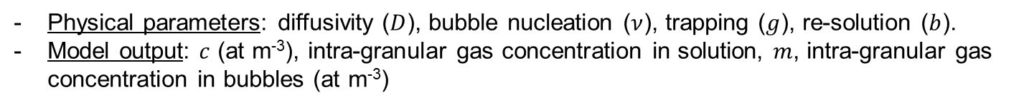
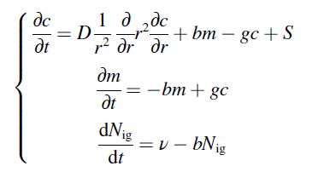
The SCIANTIX code, intra-granular fission gas behaviour
Gap
Pellet
Grain boundary
Grains
Cladding
Grain boundary
Intergranular bubbles

Slide 30
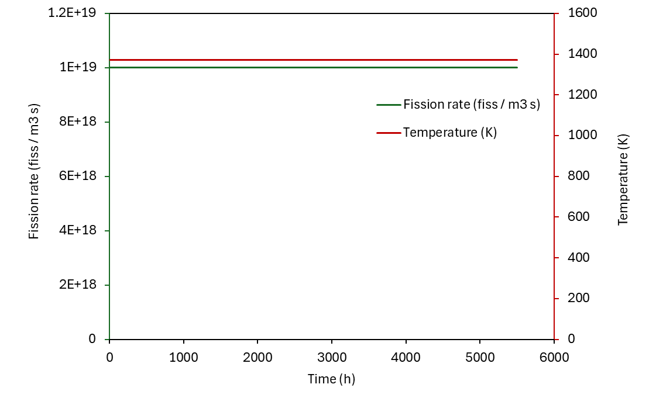

Simulation case: stationary irradiation conditions
input_history.txt
Constant temperature, 1373 K
Constant fission rate density, 10¹⁹ fiss m⁻³ s⁻¹
Zero hydrostatic stress applied
The irradiation time is 5500 hours

Slide 31
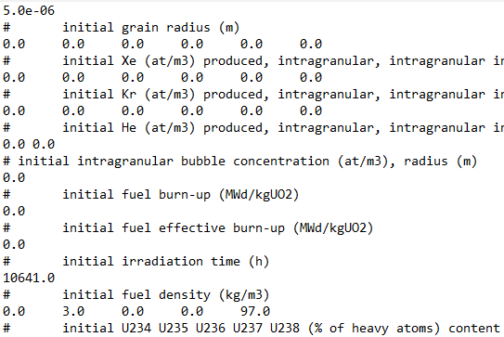
Simulation case: stationary irradiation conditions
input_initial_conditions.txt
Fresh, unirradiated UO₂, 3%at.-enriched
Grain radius = 5 µm

Slide 32
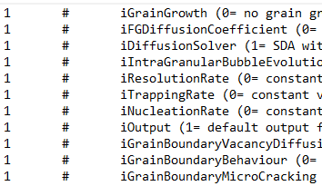
Simulation case: stationary irradiation conditions
input_settings.txt
Each entry corresponds to a modelling option for a specific physical phenomenon
In this tutorial, we use default settings, which includes validated models for the physical phenomena of interest

Slide 33
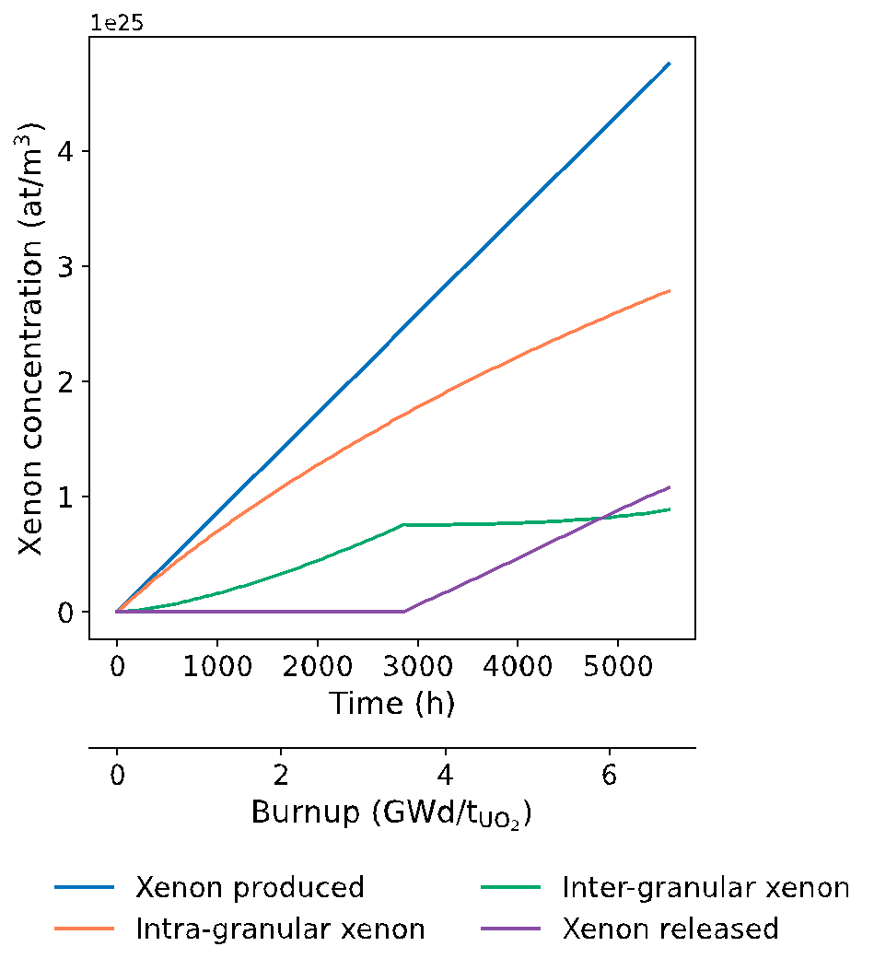
Simulation results: stationary irradiation conditions
The xenon produced (blue line) increases linearly as the product between the xenon fission yield, fission rate and irradiation time
A fraction of the gas produced remains in the grain (orange line) as gas in solution and gas in the bubbles
The gas that reaches the grain boundary (green line) is eventually released (violet line) when the saturation of the grain boundary is reached

Slide 34
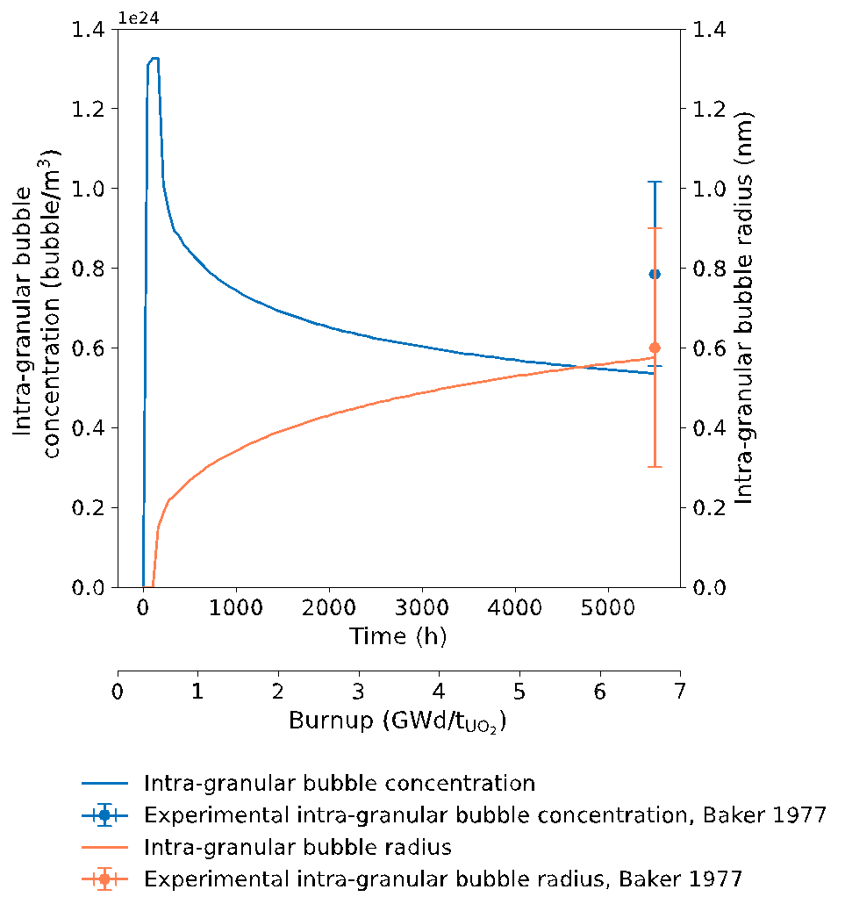
Simulation results: stationary irradiation conditions
The initial increase of intra-granular bubble concentration (blue line) is due to the nucleation
As the intra-granular bubble radius (orange line) increases steadily as a result of trapping, the intra-granular bubble concentration decreases with burnup
Notes:
Another important result of the simulation is the evolution of the intra-granular bubble concentration.
At the beginning of the irradiation, many small bubbles nucleate inside the grains, leading to a sharp increase in bubble concentration.
After that, the bubble concentration decreases with time because of the re-solution process.
This phenomenon is a key feature of the microstructural evolution of nuclear fuel under irradiation and impacts both swelling and fission gas release.
Lastly, as irradiation progresses, the bubble radius increases due to the trapping of additional gas atoms.

Slide 35
Getting Started with SCIANTIX: Transient Case Simulation
Elisa Cappellari
Notes:
Numerazione corretta

Slide 36

The SCIANTIX code, inter-granular fission gas behaviour
Fission gases, from the intra-granular diffusion, are accumulated in grain-boundary bubbles
Grain-boundary bubble evolution leads to fission gas release and gaseous swelling
Gap
Pellet
Grain boundary
Grains
Cladding
Grain
Grain boundary
Fission gas release
Trapping
Re-solution
Fission gas in grain-boundary bubbles

Slide 37
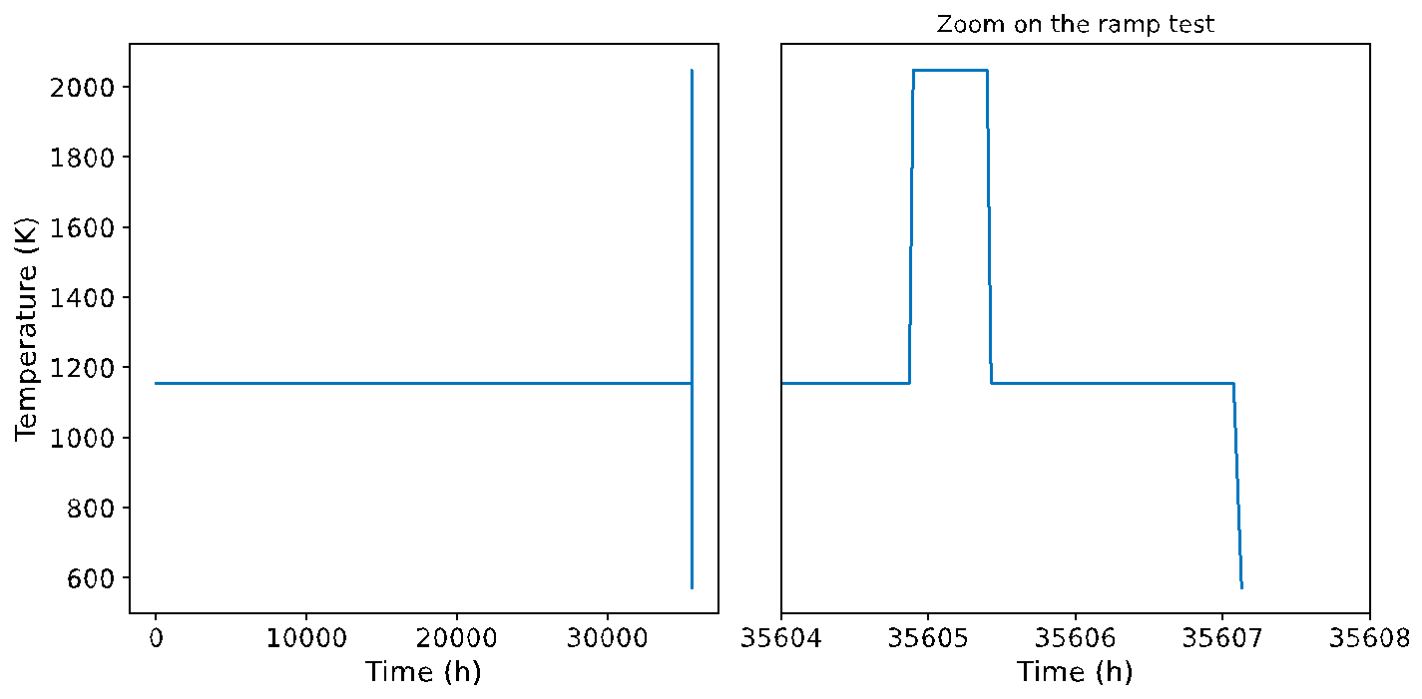
Simulation case: transient irradiation conditions
One of the experimental UO₂ sample of White, 2004 to showcase the SCIANTIX capabilities in a case of irradiation under transient conditions

Slide 38
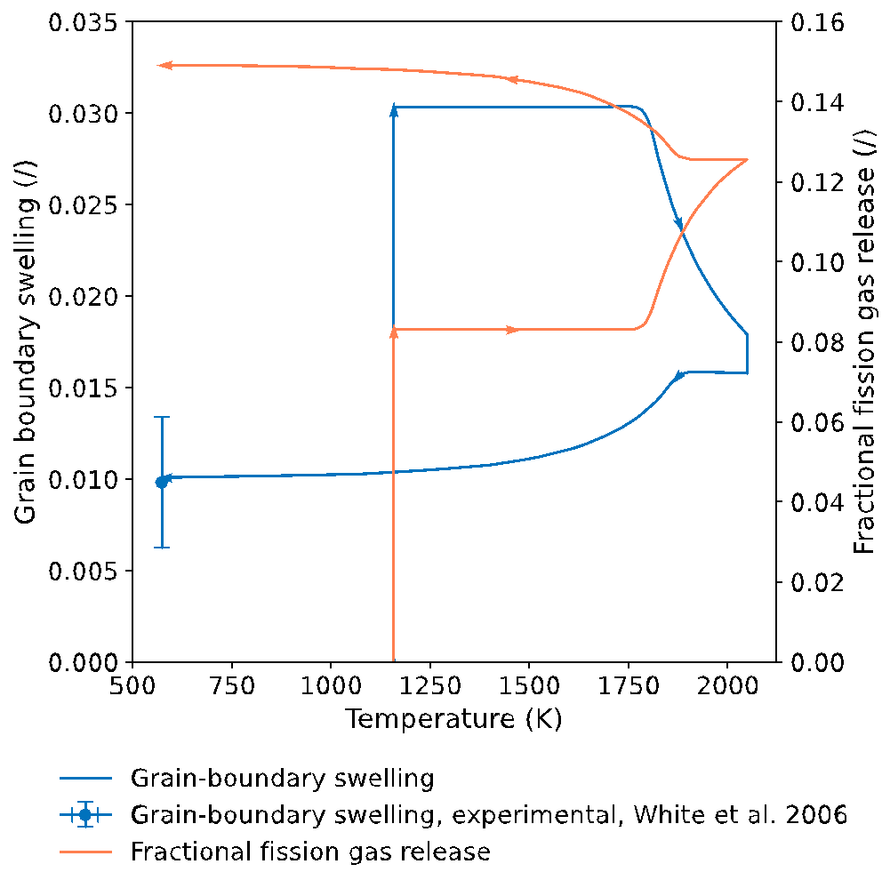
Simulation results: transient irradiation conditions
Base irradiation corresponds to the vertical line at 1157 K and the holding on top of the temperature ramp corresponds to the vertical line at 2048 K
The increase of grain-boundary swelling during the base irradiation is due to the absorption of vacancy
The reduction in grain-boundary swelling during the heating and cooling transient arises from the burst release triggered by grain-boundary micro-cracking (Barani et al., 2017)

Slide 39
References
Baker, C. (1977). The fission gas bubbles distribution in uranium dioxide from high temperature irradiated SGHWR fuel pins. Journal of Nuclear Materials, 66, 283–291. https://doi.org/10.1016/0022-3115(77)90117-9
Pizzocri, D., Barani, T., & Luzzi, L. (2020). SCIANTIX: A new open source multi-scale code for fission gas behaviour modelling designed for nuclear fuel performance codes. Journal of Nuclear Materials, 532, 152042. https://doi.org/10.1016/j.jnucmat.2020.152042
Zullo, G., Pizzocri, D., & Luzzi, L. (2023). The SCIANTIX code for fission gas behaviour: Status, upgrades, separate-effect validation, and future developments. Journal of Nuclear Materials, 587, 154744. https://doi.org/10.1016/j.jnucmat.2023.154744
White, R. J. (2004). The development of grain-face porosity in irradiated oxide fuel. Journal of Nuclear Materials, 325(1), 61–77. https://doi.org/10.1016/j.jnucmat.2003.10.008
Zullo, G. (2024). Development and assessment of an open-source code for fission gas and volatile fission products behaviour in LWR fuel (PhD dissertation, Politecnico di Milano). https://www.politesi.polimi.it/handle/10589/228452
Barani, T., Bruschi, E., Pizzocri, D., Pastore, G., Van Uffelen, P., Williamson, R. L., & Luzzi, L. (2017). Analysis of transient fission gas behaviour in oxide fuel using BISON and TRANSURANUS. Journal of Nuclear Materials, 486,96–110. https://doi.org/10.1016/j.jnucmat.2017.01.050

Slide 40
Thank you for your attention

